Slide 1



PRICING PROPOSAL AND STRATEGY

Slide 2

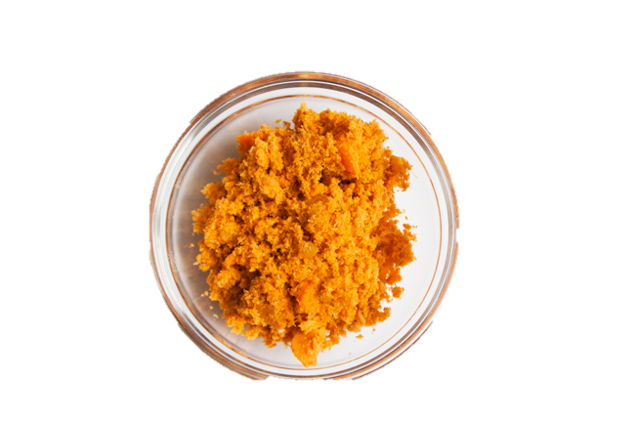

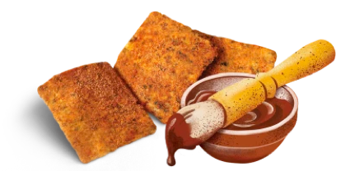
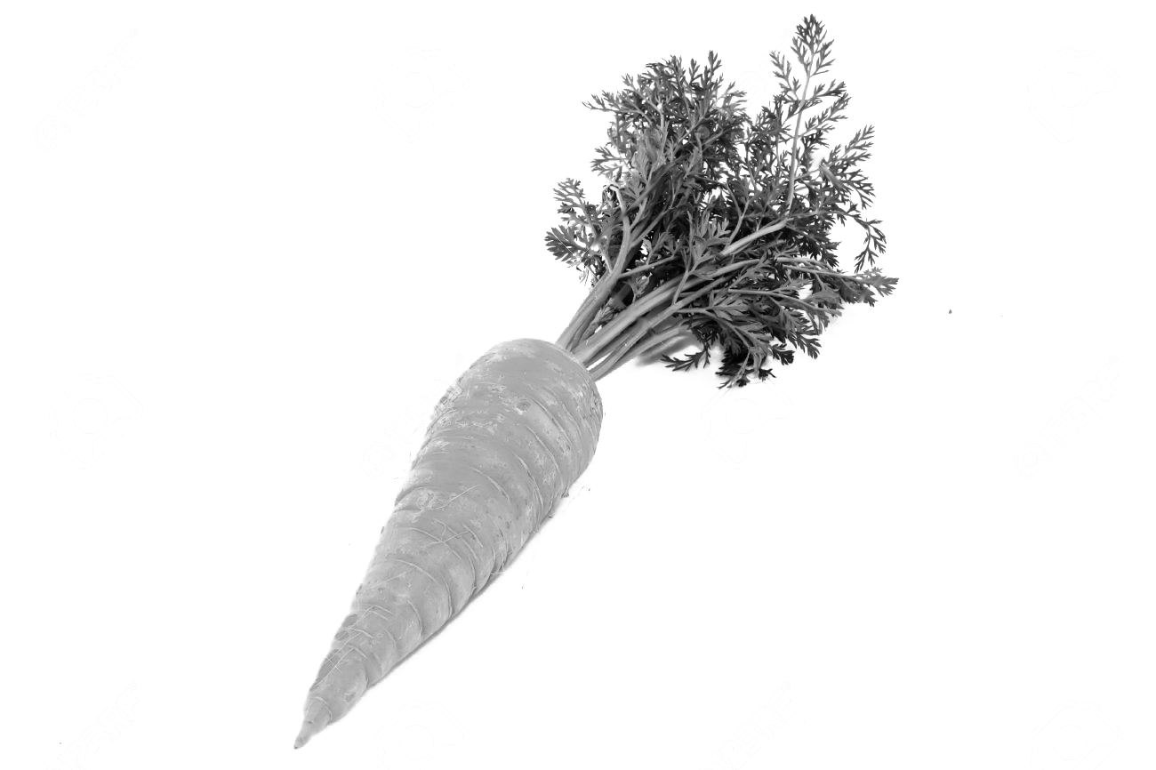
“Waste is not waste until wasted.”
1.3 Billion Tons Waste
/ year

Slide 3
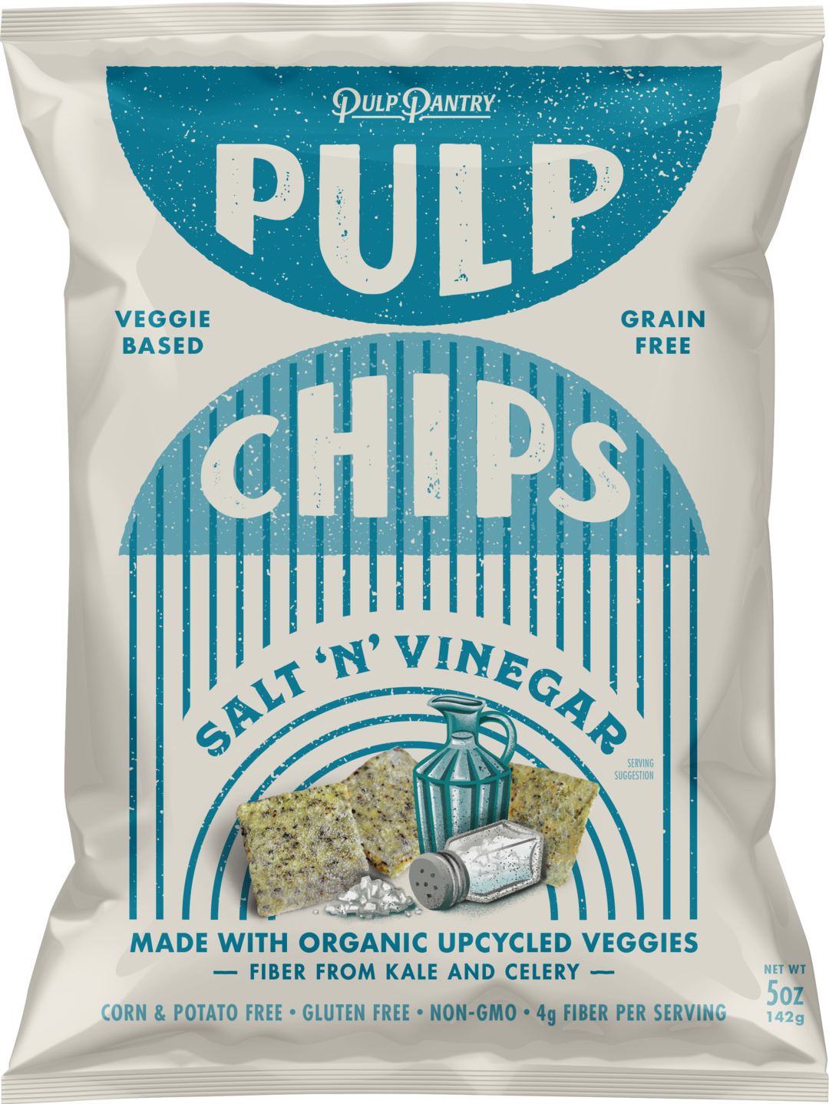
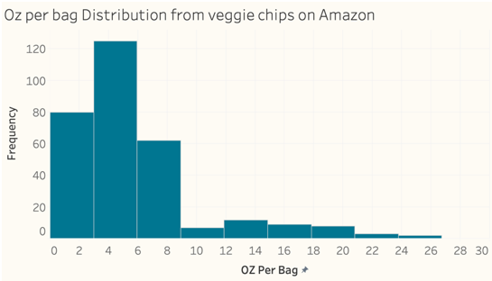
Glance at the Market – Bag Size
5 OZ
1.5 OZ

Slide 4


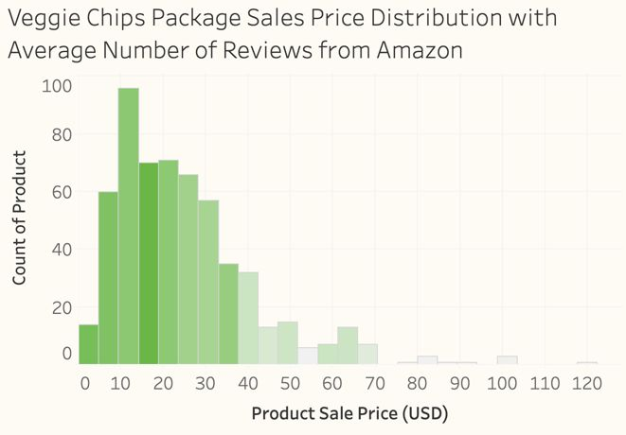
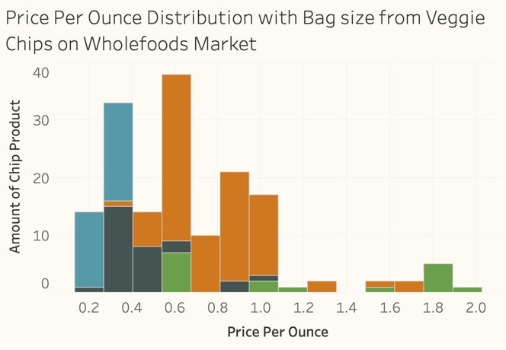
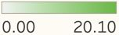
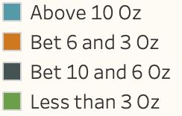
Glance at the Market - Price

Slide 5
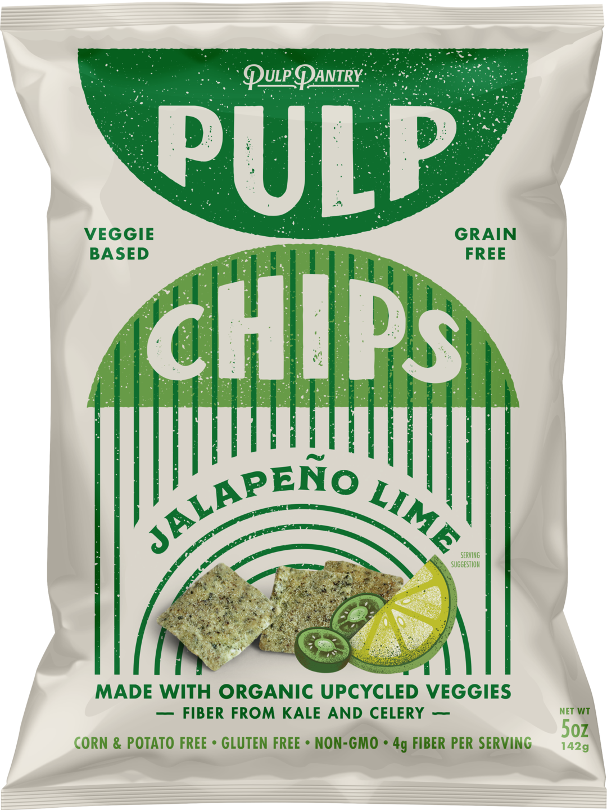
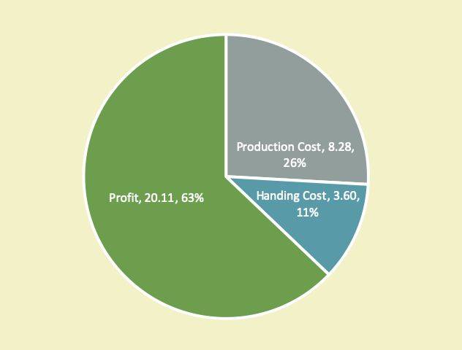
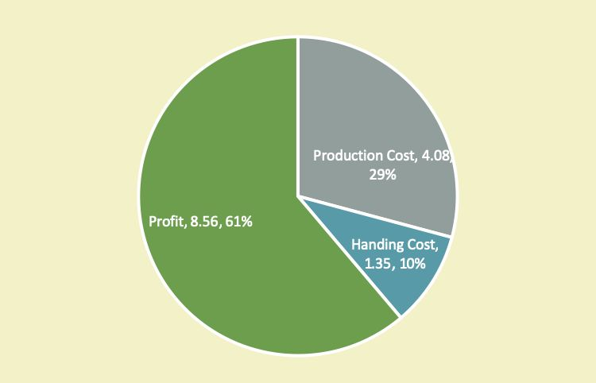
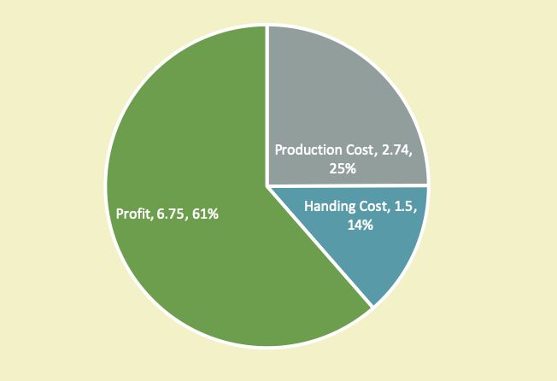
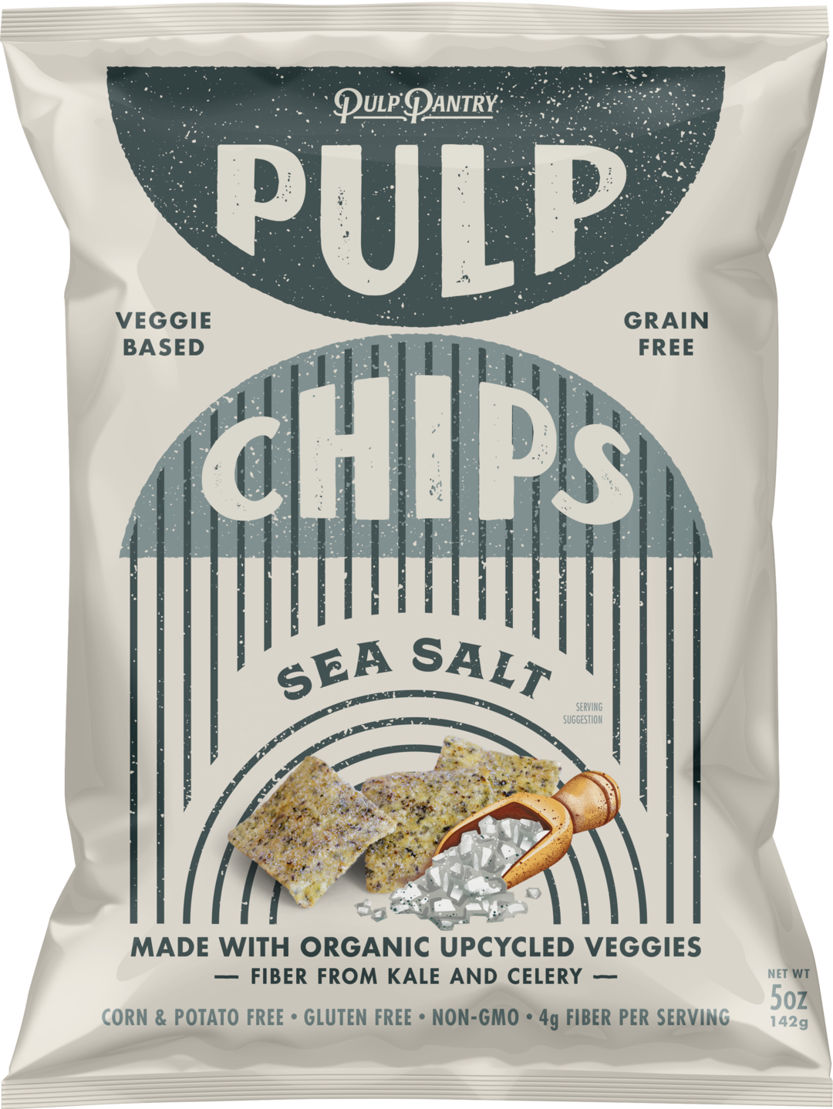
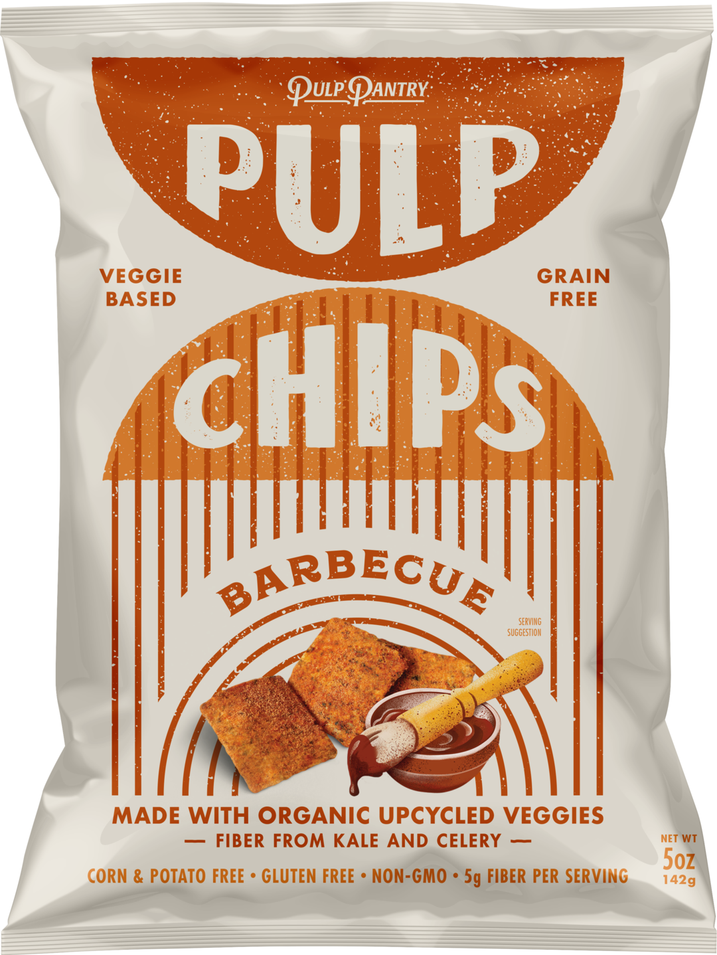
OUR PACKAGE
$13.99
$0.92/oz
1.5oz*18
$31.99
$1.18/oz
$13.99
$0.92/oz
$10.99
$1.16/oz

Slide 6
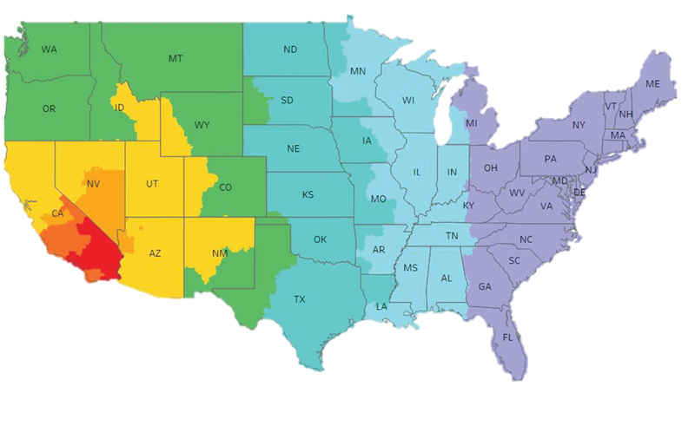
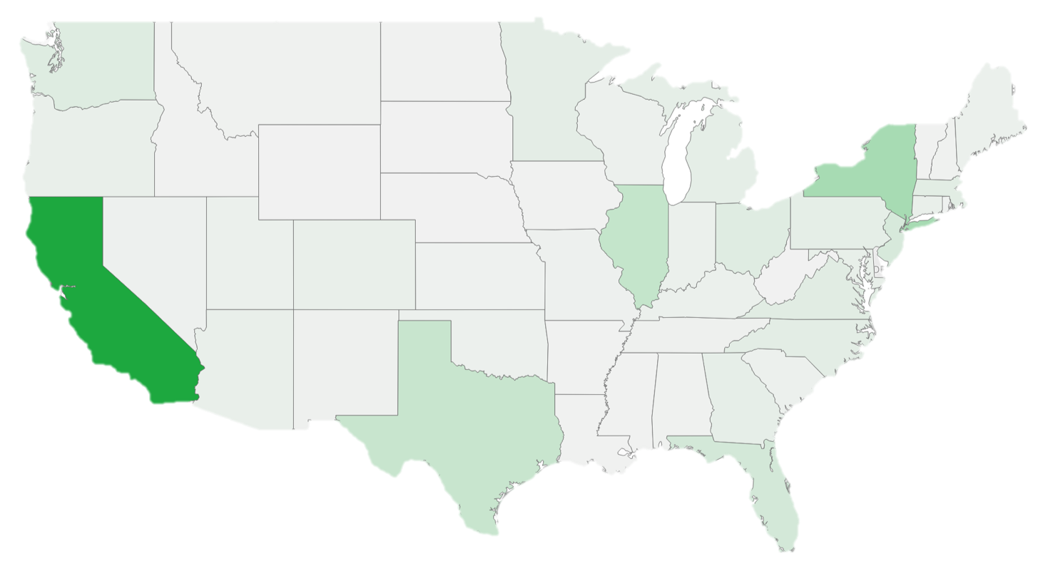

Shipping Zone and Granola Sales in US

Slide 7
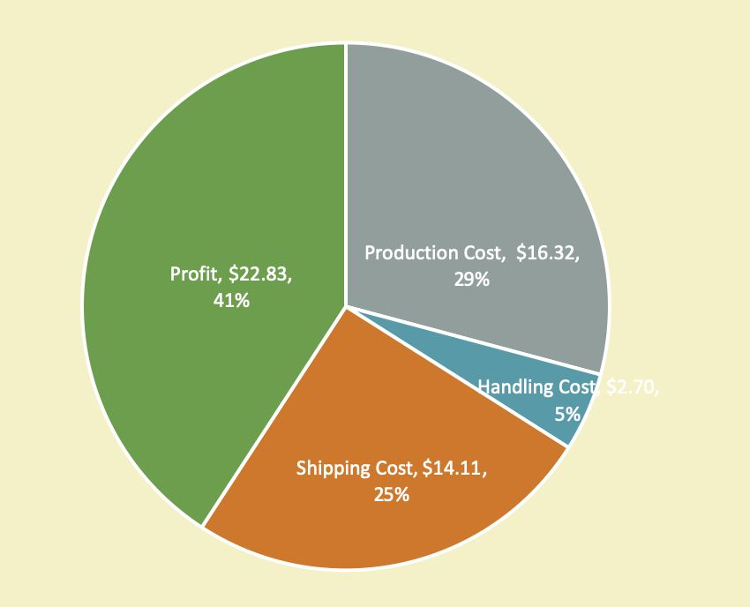
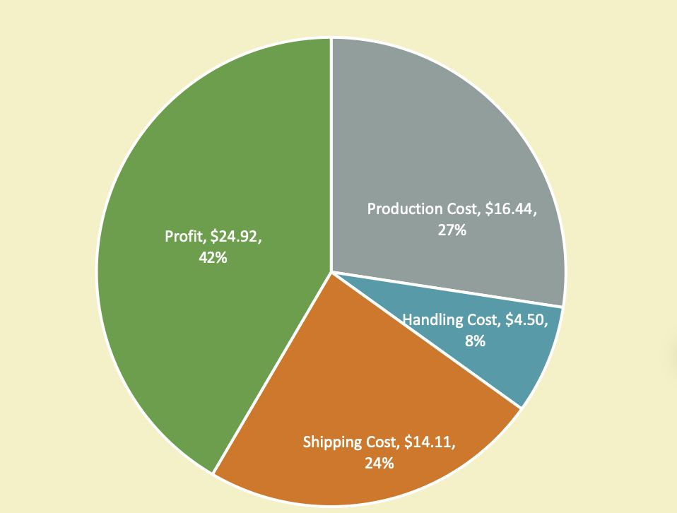
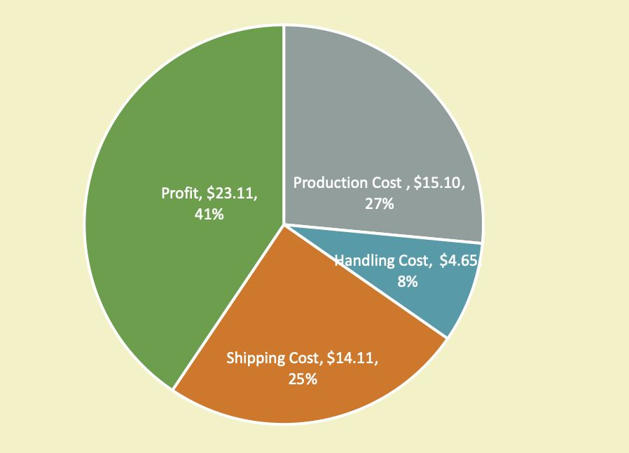
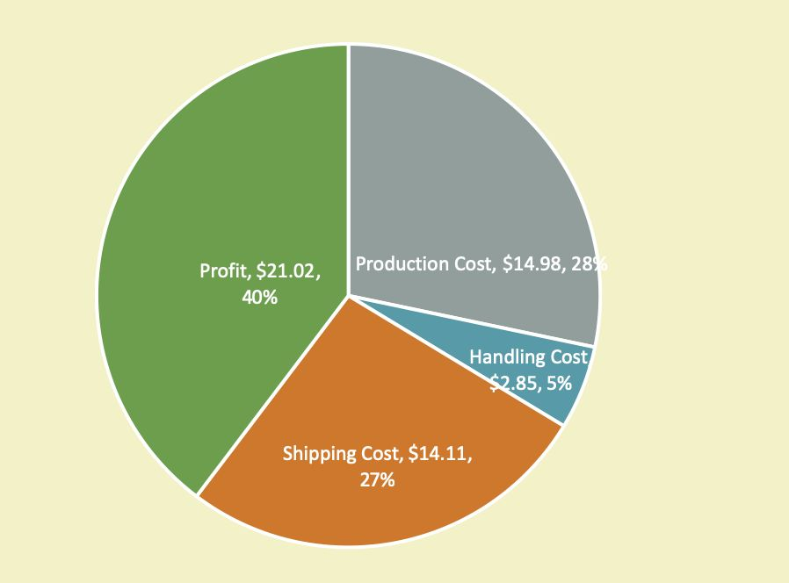
50$ SHIPPING FREE
$55.95
$59.97
$56.97
$52.96

Slide 8
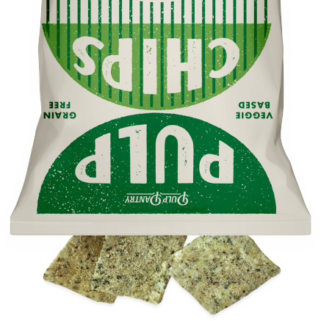
Strategy for
increasing
wholesalers'
purchases

Slide 9
Stable
income
Brand
promotion
Establish
brand image
The Pros of doing business
with the wholesaler
Lower
cost

Slide 10
Brand
promotion
Stable
income
Establish
brand image
The Pros of doing business
with the wholesaler
Lower
cost

Slide 11
Stable
income
Brand
promotion
Establish
brand image
The Pros of doing business
with the wholesaler
Lower
cost

Slide 12
Brand
promotion
Stable
income
Establish
brand image
Lower
cost
The Pros of doing business
with the wholesaler

Slide 13
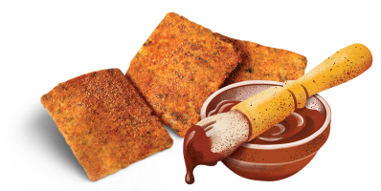
Plan A
for Risk -aversive small wholesaler
1.5OZ x 35 bags
$37.99/case & Shipping Free
Retail price must not be lower than $2.49/bag
50% of retail profits will be paid to
Pulp Pantry as a
final payment
5OZ
x 15 bags
$44.99/case & Shipping Free
Retail price must not be lower than $5.99/bag
50% of retail profits will be paid to Pulp Pantry as a final payment

Slide 14
Plan A
for Risk -aversive small wholesaler
1.5OZ x 35 bags
Profit Margin:
Sell more than one case in a single order，the PM
will be no less than 47%
And if sell more than 3 cases once,
the PM will be no less than 51%
Including shipping
cost
5OZ
x 15 bags
Profit Margin:
Including shipping cost
Sell more than one case in a single
order，the PM will be no less than 40%
And if sell more than 4 cases once, the PM will be no less than 45%

Slide 15
Plan B
For Small-scale wholesalers with limited economic capacity
$49.99/case BUT NO Shipping Free
Pay after delivery
Wholesalers only need to
settle the payment
within one month.
1.5OZ x 35 bags
$58.99/case
BUT NO Shipping Free
Pay after delivery! Wholesalers
only need to settle the payment within one month.
5OZ x 15 bags

Slide 16
Plan B
For Small-scale wholesalers with limited economic capacity
$49.99/case BUT NO Shipping Free
The Profit Margin would be
no less than 56%
No Matter how many cases
are sold in a single order
1.5OZ x 35 bags
$58.99/case
BUT NO Shipping Free
The Profit Margin would be no less than 56%
No Matter how many cases are sold in a single order
5OZ x 15 bags

Slide 17
Plan C
for The Customers who are willing to sign a long-term contract with us （more than one year）
Variable Prices & Shipping Free
See Exhibit 1 for details.
To enjoy the member price, the
customer needs to sign a contract of one year or more.
The contract will provide the parties
with the relevant content of the liquidated damages

Slide 18
Plan C
for The Customers who are willing to sign a long-term contract with us （more than one year）
Variable Prices & Shipping Free
See Exhibit 1 for details.
Suppose a wholesale customer from the East Coast signs a one-year sales contract with us, buying 15 cases per month.
The annually net profit will be:
$2050.68 For 1.5oz x 35bags
or
$3074.4 For 5oz x 15bags

Slide 19
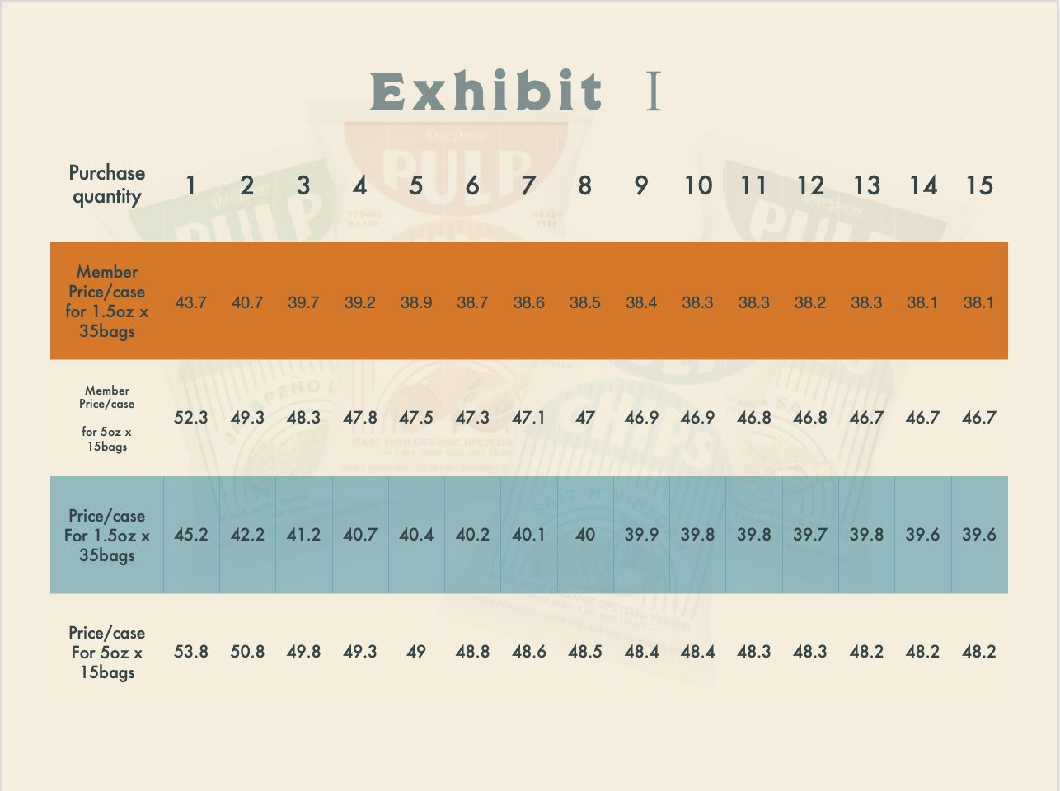

Slide 20

Plan D
Variable Prices
But NO Shipping Free
See Exhibit 1 for details.
Each price is $1.5 higher than the member price.
Customers can enjoy a 10% discount on the second purchase.
New customers only
1.5OZ x 35 bags
For budgeted or large wholesalers
Who prefer variable prices

Slide 21


Slide 22
Plan D
Variable Prices
But NO Shipping Free
See Exhibit 1 for details.
Each price is $1.5 higher than the member price.
Customers can enjoy a 10% discount on the second purchase.
New customers only
1.5OZ x 35 bags
For budgeted or large wholesalers
Who prefer variable prices

Slide 23
Plan D
1.5OZ x 35 bags
For the first order,
our profit margin will be no less than 53%
no matter how many cases are sold in a single order
For the second order with one-time discount price,
our profit margin will still be no less than 48%
For the first order, our PM will be no less than 52%
For the second order with a one-time discount, our PM will still be no less than 47%
1.5OZ x 35 bags
5OZ x 15 bags
For budgeted or large wholesalers
Who prefer variable prices

Slide 24
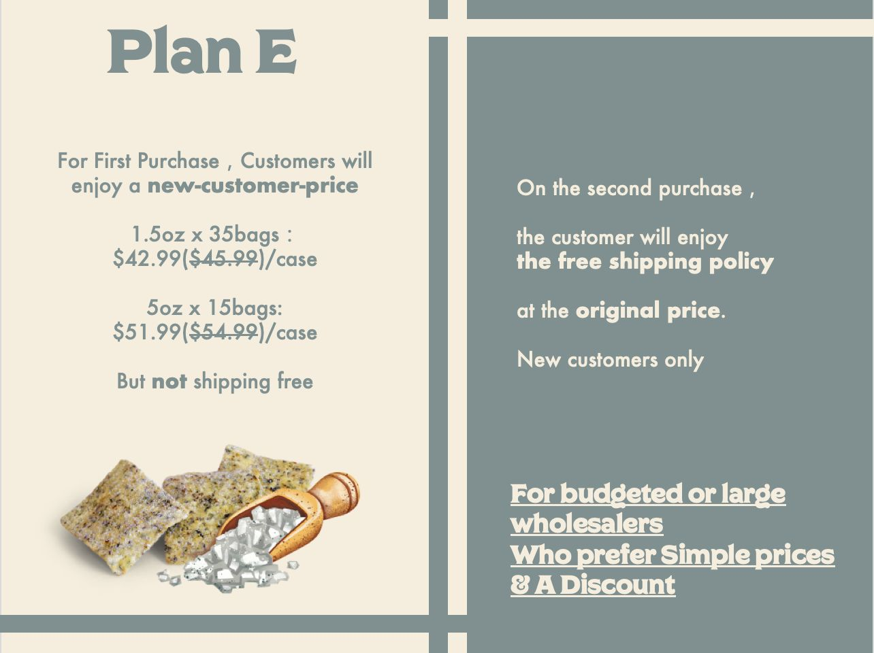

Slide 25
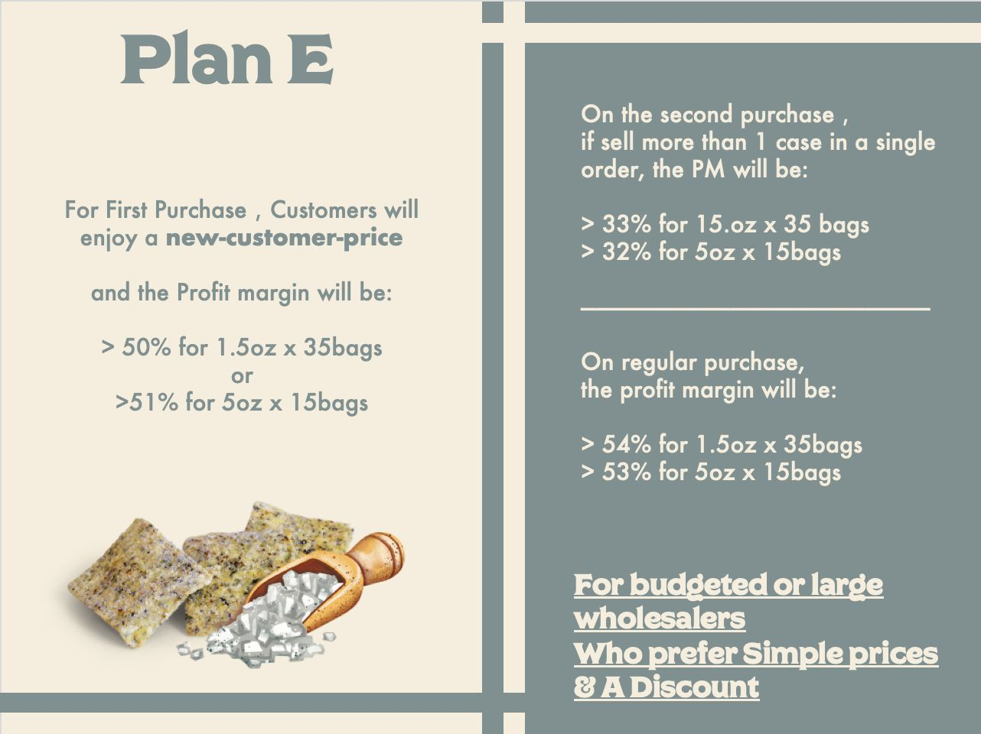

Slide 26
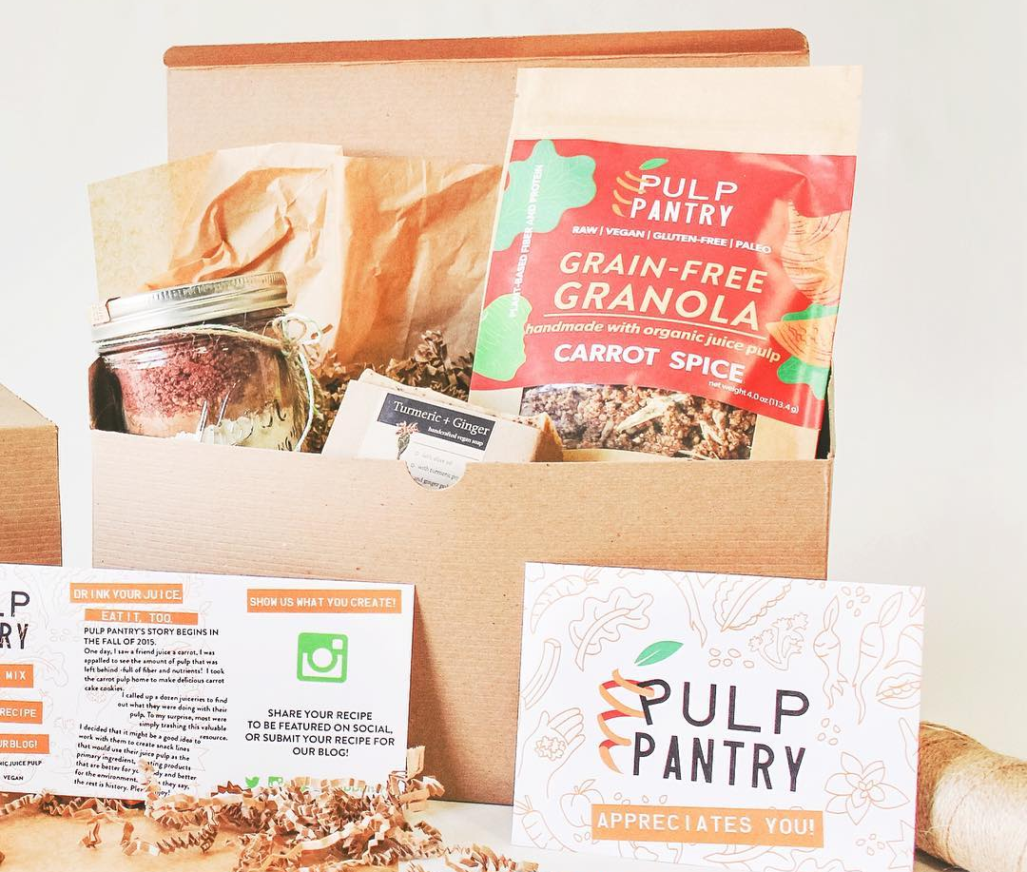


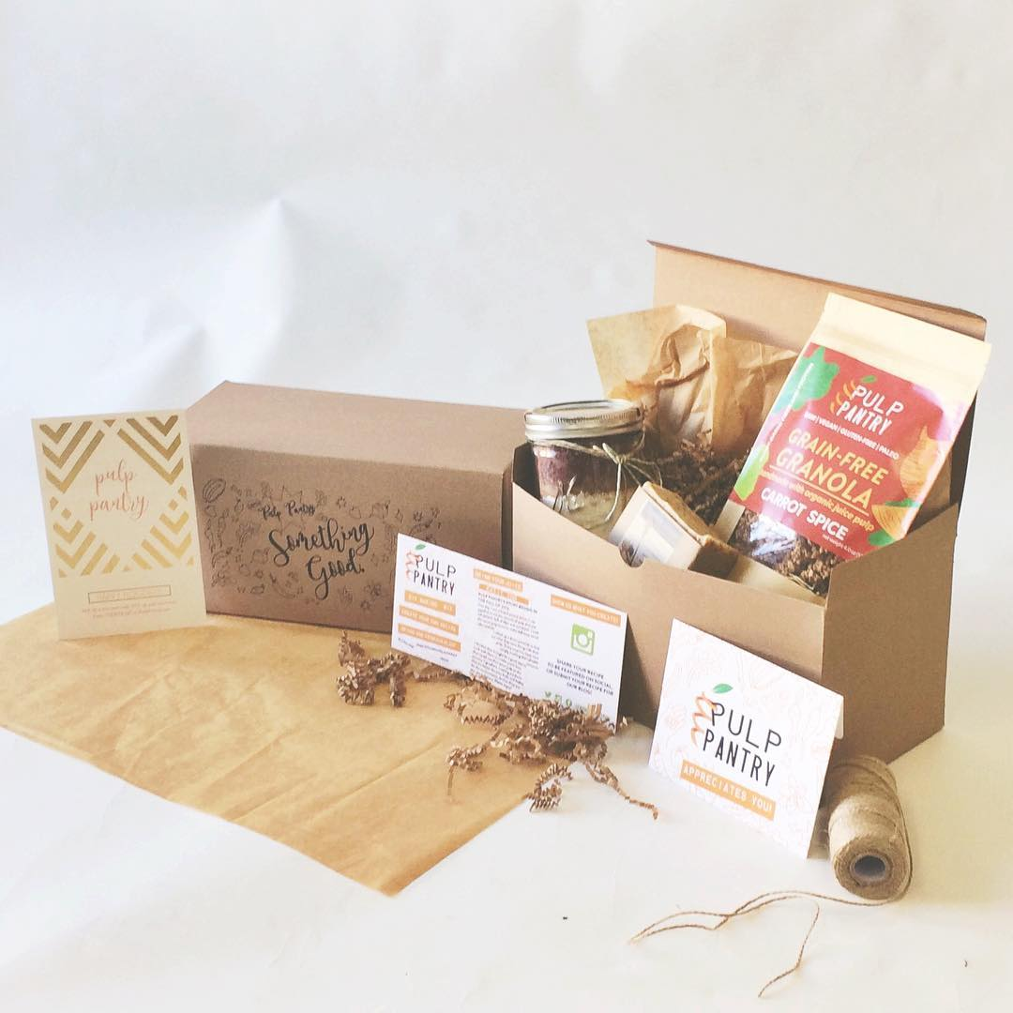
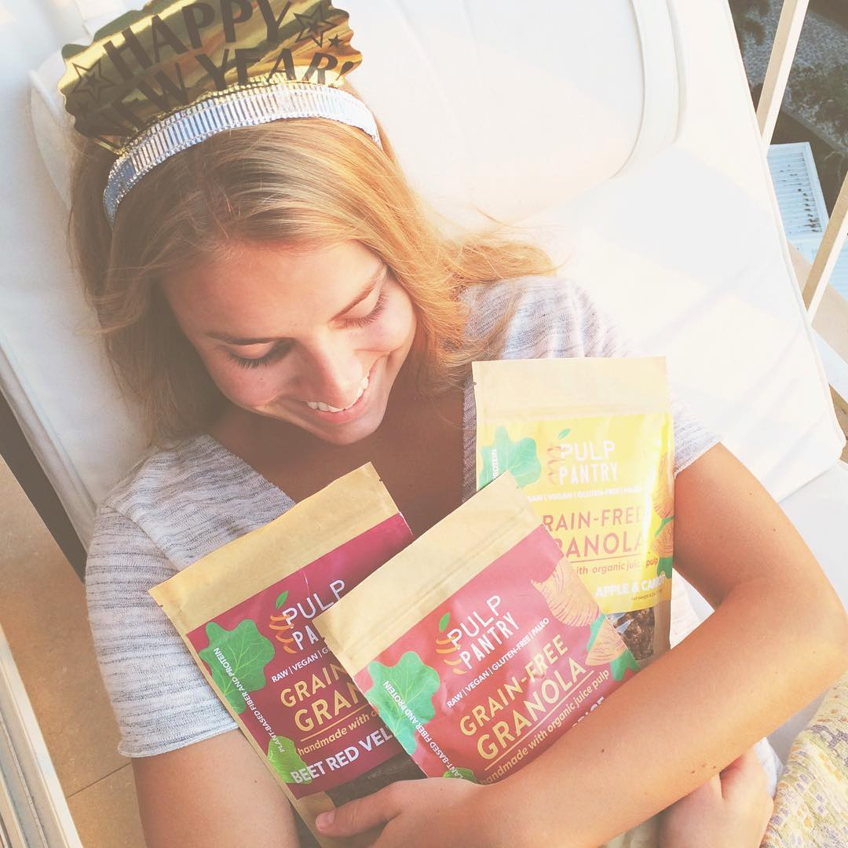
MONTHLY SUBSCPRITION
Why subscription?
Why customers make subscriptions?

Slide 27
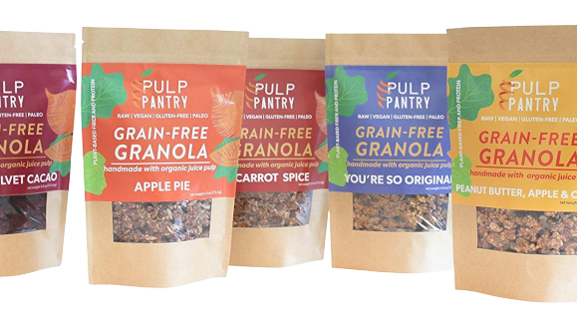
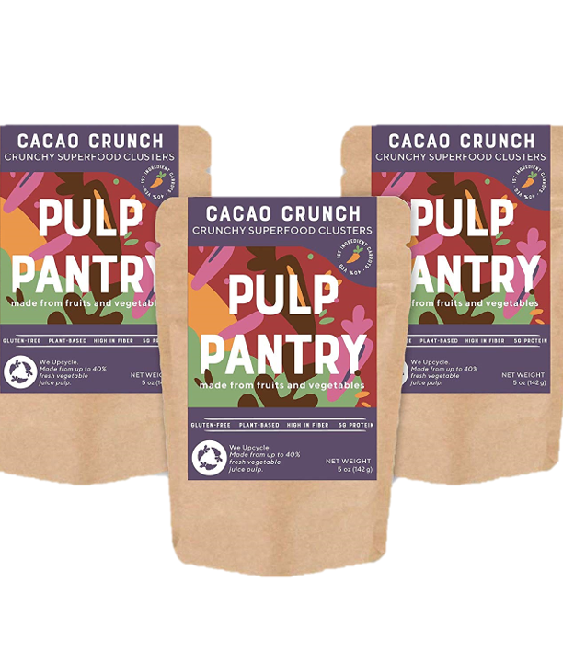
WHAT'S IN THE BOX?
Pulp Chips
Grain-Free Granola Bites
Cacao Crunch
Veggie Chips
Newly-Published Products
1.5oz X 25 bags/Month

Slide 28
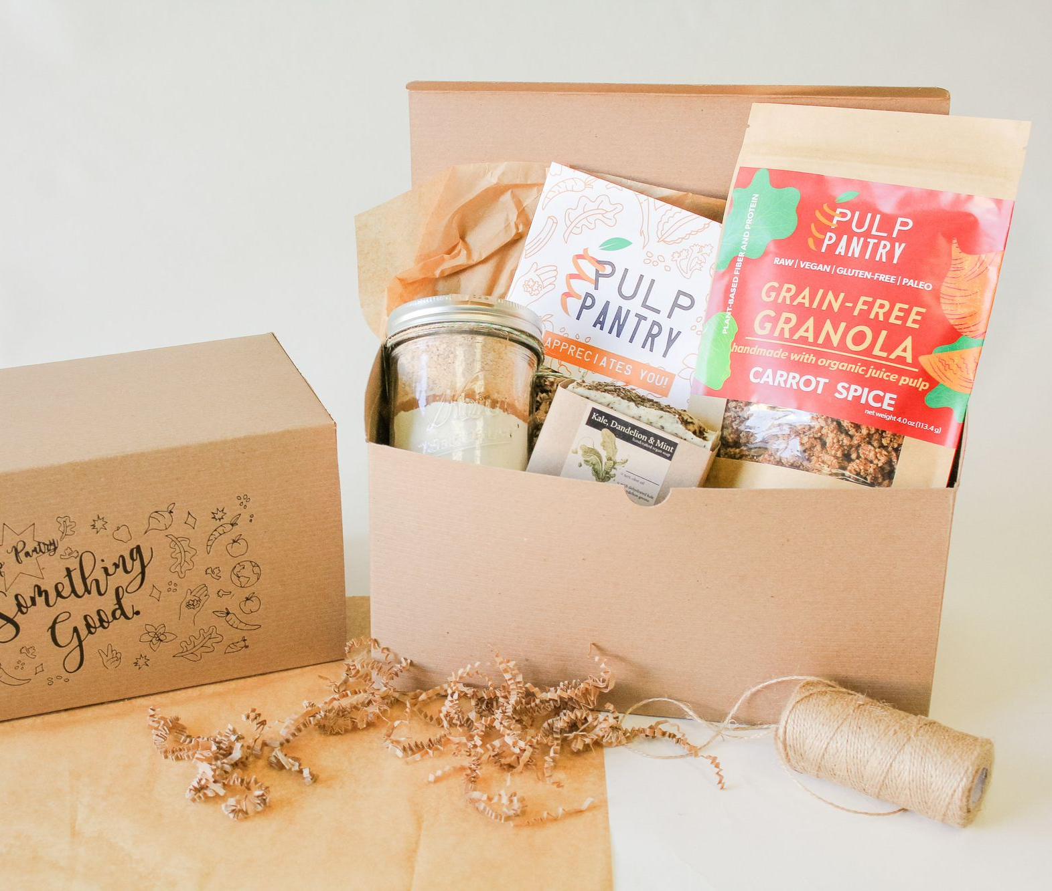
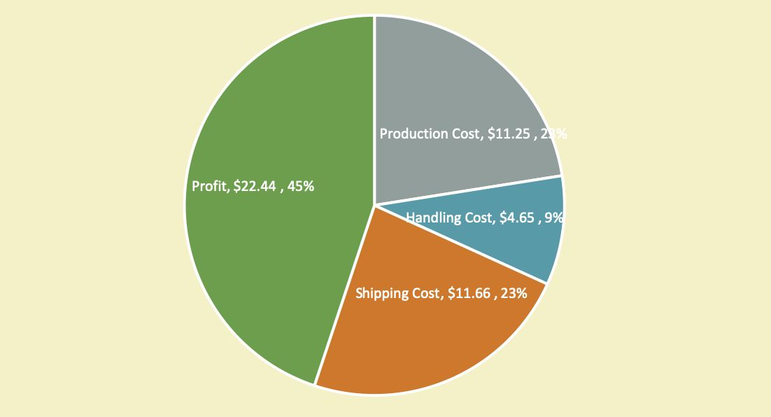
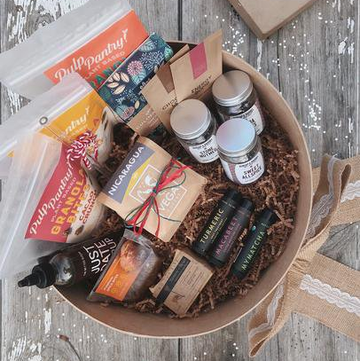
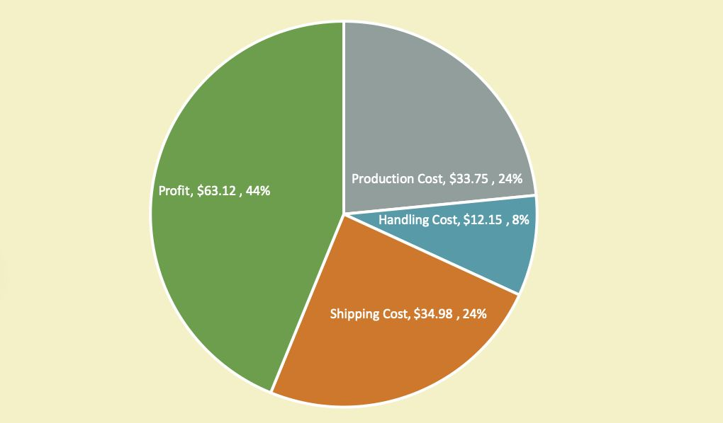
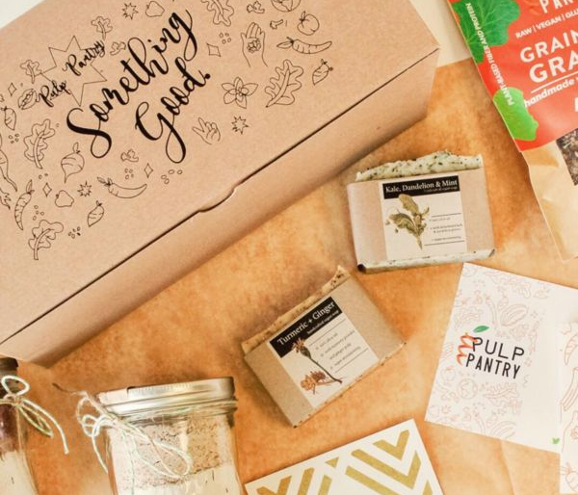
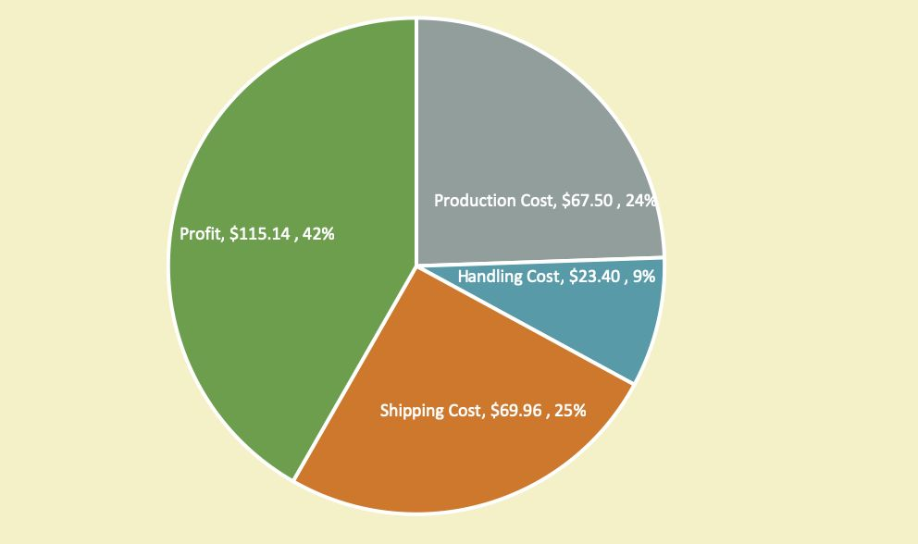
CHOOSE YOUR SUBSCRIPTION PLAN
PAY MONTHLY
$50 / MONTH Cancel or pause at any time.
Shipping included!
PREPAY
3 MONTHS
$48 / MONTH
(SAVE 4%)
Shipping included!
PREPAY
6 MONTHS
$46 / MONTH
(SAVE 8%)
Shipping included!

Slide 29

THANK YOU VERY MUCH , ANY QUESTIONS?

